Slide 1

Introduction
to Web
Development

Slide 2
JavaScript
as a Programming Language
Notes:
Created to add some logical parts on the websites, called as a script language - executed with help of script engines like V8 on chrome and opera- spidermonkey or chakra..
Things JS can do on page:
Add new HTML to the page, change the existing content, modify styles.
React to user actions, run on mouse clicks, pointer movements, key presses.
Send requests over the network to remote servers, download and upload files (so-called AJAX and COMET technologies).
Get and set cookies, ask questions to the visitor, show messages.
Remember the data on the client-side (“local storage”).

Slide 3
Why learn Javscript?
Notes:
JavaScript allows you to build interactive websites.
JavaScript usage has now extended.t works on the server with nodejs, it has been working in browsers since 1995, it works on Internet Of Things Devices, it’s used to build performant native apps, it’s used to make cross-platform desktop apps, it’s used to power smart TVs

Slide 4
Javascript Variables
variables are containers for storing data values
Declaration : var x ; // Here var is the Keyword
To assign value: x = 2;
x = “hello”;
console.log(x);
These both can be written together as:
var x = 2;
Declaring many Variables together:
var x = 2 , y = 4, z = 6;
By default value of any javascript variable is undefined.

Slide 5
Javascript Operators
There are many types of javascript operators :
Javascript arithmetic operators
eg: + , - , * , / , %, ++ , --
2. Javascript assignment operators
eg: = , += , -= , *= , /= , %=
3. Javascript String operators
eg: + , +=
4. Javascript comparison operator
eg: == , === , != , !== , > , < , >= , <= , ?
5. Javascript logical operators
eg: && , || , !
Notes:
5

Slide 6
Javascript Arithmetic
var x = 6;
var y = 3;
var z = x + y; // z = 9
var z = x - y ; // z = 3
var z = x * y; // z = 18
var z = x / y; // z = 2
var z = x % y; // z = 0
x++ ;
var z = x; // z = 7
x-- ;
var z = x; // z = 6;
Notes:
6

Slide 7
Operator Precedence
var x = ( 100 + 50) * 3 ;
x = ??
var x = 100 + 50 * 3;
x = ??
Here comes the use of precedence table which determines which operator should be operated first .
and * has higher precedence than +
Notes:
7

Slide 8
Javascript Assignment Operator
These are used for assigning value to javascript variables.
var x = 10 ; x +=5
x = ?? x = ??
x -= 5 ; x *= 5;
x = ?? x = ??
x /= 5; x%= 5;
x = ?? x = ??
Notes:
8

Slide 9
Javascript data Types
Javascript data types are dynamic .
eg: var x = 6 ;
x = “foo”;
x = true ;
There are 5 primitive data types :
Boolean
Null
Undefined
Number
String
Notes:
9

Slide 10
Booleans
This data type can have only two values : true or false
eg : var x = 5;
var y = 5;
var z = 6;
var boo = (x==y);
boo = ??
var boo = (x==z);
boo = ??
Notes:
10

Slide 11
Undefined and null values
If we don’t assign values to variables by default its value is undefined.
eg : var ;
x = ??
The value null represents the intentional absence of any object value. In simple words, a sense of emptiness.
eg. var p = null;
Notes:
11

Slide 12
There is a special operator ‘typeof’ used for finding data type of a variable.
eg: typeof “ ” ; // returns “string”
typeof “cgch” ; // returns “string”
typeof 0 // returns “number”
typeof (3+4); // returns “number”
typeof undefined; // returns “undefined”
typeof true // returns “Boolean”
Notes:
12

Slide 13
Javascript Object
These are variables too but can contain many values .
var car = {
type :"Fiat",
model:"500",
color:"white"
};
We can access these object properties in two ways :
objectName.PropertyName
objectName[“PropertyName”]
eg : car.type // returns Fiat
car["type"] // returns Fiat
car.model // returns 500
car["model"] // returns 500
Notes:
13

Slide 14
Javascript Functions
A javascript function is a block of code used to design a particular task.
Syntax:
function name(parameter1, parameter2, parameter3) {
code to be executed
}
Example:
var x = myFunction(4, 3); // x = 12
function myFunction(a, b) {
return a * b;
}
Notes:
14

Slide 15
Objects can also have function as their property and such functions are called methods .
A method can access the property of its own object using this keyword .
var person = {
firstName : "Alex",
lastName : "Hunter",
id : 5566,
fullName : function() {
return "Alex Hunter"
}
};
var name = person.fullName();
name = ??
Notes:
15

Slide 16
Javascript Events
An HTML event can be something the browser does, or something a user does.
<button onclick="displayDate()">Today is ?</button>
<script>
function displayDate() {
alert("Today is : " + Date(Date.now()));
}
</script>
In both of these examples onclick is an event
Notes:
16

Slide 17
Arrays
An array is a special variable, which can hold more than one value at a time.
Example
var cars = [“Benz", "Volvo", "BMW"];
Accessing values of array :
You access an array element by referring to the index number.
Example:
var name1 = cars[0]; // name1 = Benz
var name2 = cars[1] // name2 = Volvo
Notes:
17

Slide 18
Array Properties and Methods
var fruits = ["Banana", "Orange", "Apple", "Mango"];
fruits.length; // the length of fruits is 4
fruits.sort(); // fruits = [“Apple” , “Banana” , “Mango” , ”Orange” ]
fruits.push(“lemon”);
// fruits = [“Apple” , “Banana” , “Mango” ,”Orange” ,”lemon”]
Notes:
18

Slide 19
Javascript Strings
A JavaScript string is zero or more characters written inside quotes.
Example : var x = “John Doe”
var x = “5”
The length of a string is found in the built in property length:
var y = x.length; // y =1
Special Characters
If string contains quotes then we can use special characters
var x = "We are the so-called "Vikings" from the north.";
// error: so to avoid this backslash is used.
var x = "We are the so-called \“Vikings\" from the north."
or var x = ‘We are the so-called "Vikings" from the north.’
Notes:
19

Slide 20

The HTML DOM Tree of Objects
Notes:
20

Slide 21
There are couple of ways to access HTML elements.
Example:
var x = document.getElementsByTagName("p");
var x = document.getElementsByClassName("container");
var myElement = document.getElementById("intro");
Notes:
21

Slide 22
Changing HTML
To change the content of an HTML element, use this syntax:
Element.innerHTML = new HTML
Eg.
var element = document.getElementById("info");
element.innerHTML = "The Programming Club of IIT (ISM) ";
To Add Event Listener to an HTML element, use this syntax:
Element.addEventListener(event, function);
Eg.
var btn = document.getElementById("info_btn");
btn.addEventListener("click", showInfo);
where showinfo() is a function defined in the same file.
Notes:
22

Slide 23
Changing CSS
To change the style of an HTML element, use this syntax:
Element.style.property = new style
Eg.
var heading = document.getElementById(“heading");
heading.style.color = "red";
Notes:
23

Slide 24
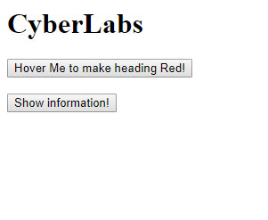
Let’s build a basic DOM based page

Slide 25
if statement:
if (true) {
console.log(“it runs when argument is true”)
} else {
console.log(“otherwise this block runs”)
}

Slide 26
For Loops :
for (initialization; condition; increment) { //this runs while the condition is true }

Slide 27
For loop example
for (var i = 0; i < 10; i++) {
console.log(i);
..
..
.
}
// prints
// 0
// 1
// 9

Slide 28
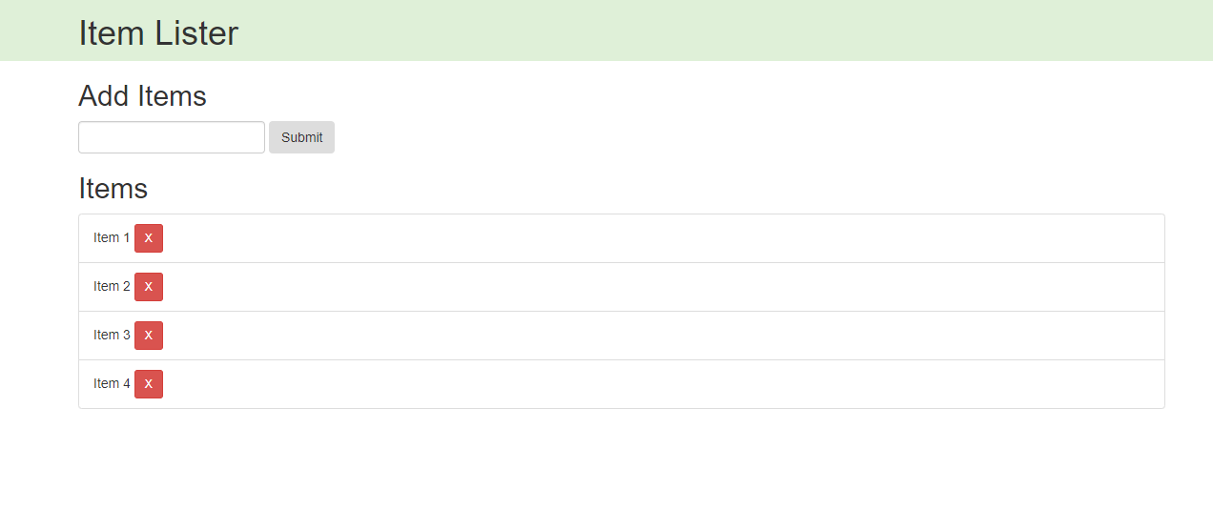
Project : Item Lister

